Slide 1


Dun-Dun.. Dun-Dun.. Dun-Dun-Dun-Dun..
Wireshark

Slide 2
Announcements
CTF Sign Ups! Head Over to our SU Page to sign up!
First Responders CTF – Sat. 2nd of Nov 10am-6pm + after party!
BAE CTF – email ctf@baesystems.com with name, team, year of study
and course title by October 16th.
CyberWomen@UWE Presents..
The Hunt for the Encrypted Elves CTF – Sat. 7th of Dec. 10am-6pm,
Christmas Treats when you capture a flag, Snacks and seasonal fun.
MEMBERSHIP!
PLEASE SIGN UP NOW!

Slide 3
More Boring Admin Stuff!!
Committee Positions Applications
Deadline: 23rd October ‘24
Please email us at contact@ctffalcons.com with the subject header
Committee Application.
Please include a short manifesto of why you’d be good for the role.
Open Positions: Social Events Officer, Society Secretary and Freshers
Experience Officer.
https://www.ctffalcons.com/committee

Slide 4

Welcome to Network Traffic Analysis!!
Resources: To get you started with Wireshark here are a list of rooms
On Tryhackme to get you started:
https://tryhackme.com/module/wireshark
https://tryhackme.com/r/room/wiresharkthebasics
https://tryhackme.com/r/room/wiresharkpacketoperations
https://tryhackme.com/r/room/wiresharktrafficanalysis
Note: If you have any questions on any of these, feel free to drop by one of our Eyas Support Drop-In sessions in the Hex Hive Tuesdays and Fridays 2-4pm.
Notes:
Our first goal is to bridge the gap between what we get taught in the classroom and what we are expected to know and be able to do in order to work in industry. To this end, we will be running three internal CTFs this year, the winners of which will receive CompTIA Security+ and Pentest+ vouchers, as well as bringing our very own guest speakers in to provide insight into what life in industry is like, and what we can do to become as desirable as possible for employers.
Our first CTF is on November 2nd, it is dubbed "First responders" and is focused on Digital Forensics and Incident Response. We will be running bootcamps every Wednesday until that point in order to help prepare everyone to take part.
Our first guest speaker is Harvey Keane, UWE alumn, Falcons member and BAE employee. He got recruited after winning the BAE CTF and will be talking to us about life after uni on October 23rd
Some people raised the question of getting insight from industry during last week's APT. We’ll not only have guest speakers in to discuss their perspectives, but we also have a card game that has been used in industry to explain and detail the relationship between the financial side of things and the cyber side of things.
Our second goal is to provide a diverse and inclusive environment for students to find peers they can bounce ideas off of, and friends they can go through thick and thin with. As such, we will be hosting a variety of social events, including but not limited to: movie nights, pool nights and touching grass.
2 hours from now, we’ll be hosting our second taster session in the Student Union’s meeting room 1, after which we will convene in the Student Union bar to celebrate having survived freshers another year, to welcome new members and say goodbye to graduating ones.

Slide 5
I think we need a bigger boat…
Once you get through the rooms in the previous slide it’s time to try
Something a little more challenging. Wireshark is often used in Digital
Forensics in Incident Response (DFIR) for determining Indicators of Compromise
(IOCs).
So here’s a few resources for you to try some DFIR focused Wireshark Challenges:
Malware Traffic Analysis:
https://www.malware-traffic-analysis.net/index.html (Hint: Think about the way
Malware behaves.) This site also has quizzes and the answers to the challenges.
http://dataset.tlm.unavarra.es/ransomware/ (This is for those DFIR Ninja’s!)

Slide 6
I think we need a bigger boat…
Once you get through the rooms in the previous slide it’s time to try
Something a little more challenging. Wireshark is often used in Digital
Forensics in Incident Response (DFIR) for determining Indicators of Compromise
(IOCs).
So, here’s a few resources for you to try some DFIR focused Wireshark Challenges:
Malware Traffic Analysis:
https://www.malware-traffic-analysis.net/index.html (Hint: Think about the way
Malware behaves.) This site also has quizzes and the answers to the challenges.
http://dataset.tlm.unavarra.es/ransomware/ (This is for those DFIR Ninja’s!)

Slide 7
Let’s go fishing…
To help you get a sense of what live network traffic looks like, and how
noisy scanning tools like nmap etc can be. I wrote a TCP Scanner/Attack
Tool in CNS to keep myself entertained. It uses Python’s scapy library so
those nerds out there feel free to pick up and play with it.
You need to network 2 VM’s together. So, try this on a UWE PC if your
Laptop struggles.
The source code can be found on the Falcons Github:
Challenges/_BootCamp at main · CTFFalcons/Challenges (github.com)

Slide 8
Let’s go fishing…
To help you get a sense of what live network traffic looks like, and how
noisy scanning tools like nmap etc can be. I wrote a TCP Scanner/Attack
Tool in CNS to keep myself entertained. It uses Python’s scapy library so
those nerds out there feel free to pick up and play with it.
You need to network 2 VM’s together. So, try this on a UWE PC if your
Laptop struggles.
The source code can be found on the Falcons Github:
Challenges/_BootCamp at main · CTFFalcons/Challenges (github.com)
To run copy the TCP SCAT source code to Visual Studio in your UWE VM
and save the file. Then execute with: sudo python3 tcpscat.py

Slide 9
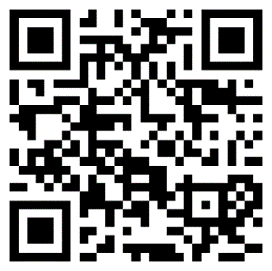
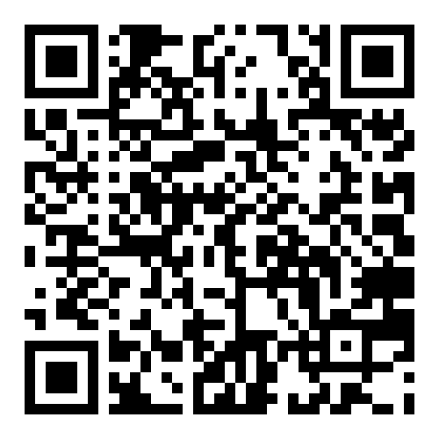
Event Sign Ups.
UWE Falcons Website
SU Membership Portal
Head to our website/SU Page and please sign up to our upcoming events

Slide 10
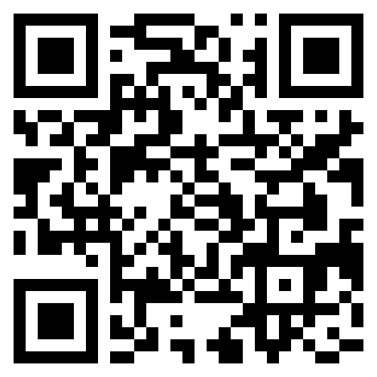

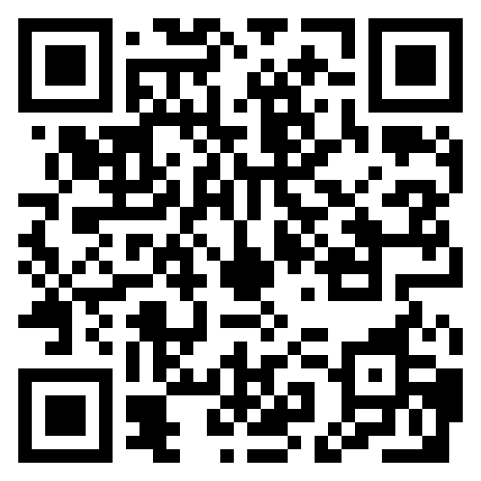
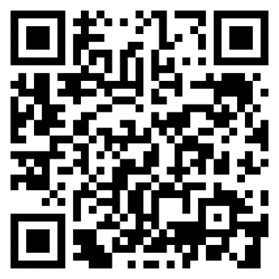
CyberWomen Groups Website
UWE CTF Falcons Website
CyberWomen@UWE LinkedIn
UWE CTF Falcons LinkedIn

